Slide 1
Data modeling of Amazon sales

Slide 2
1. Preprocessing

Slide 3
Data Cleaning and Analysis
Objective:
The goal of preprocessing is to ensure data quality and relevance for subsequent analysis tasks.
This presentation will cover key insights and decisions made during the data cleaning phase.

Slide 4
Insights from Data Cleaning
General Insights:
Identified irrelevant columns: "Unnamed: 22", "fulfilled-by", "ship-postal-code", "Country“
These columns were removed to streamline the dataset and improve clarity.
Specific Insights:
Numerical Values:
Qty: Categorized into bins, minimal impact on status
Amount: Outlier removal, minimal impact on status trends.

Slide 5
Preprocessing Categorical Data
Steps taken:
Promotions: Transformed to Boolean, significant impact on cancellation rates
Ship-state: Unified case, grouped to reduce dimensionality
Simplified ship-service-level and style categories: Removed non-significant categories
Managed and dropped redundant columns like category and SKU.

Slide 6
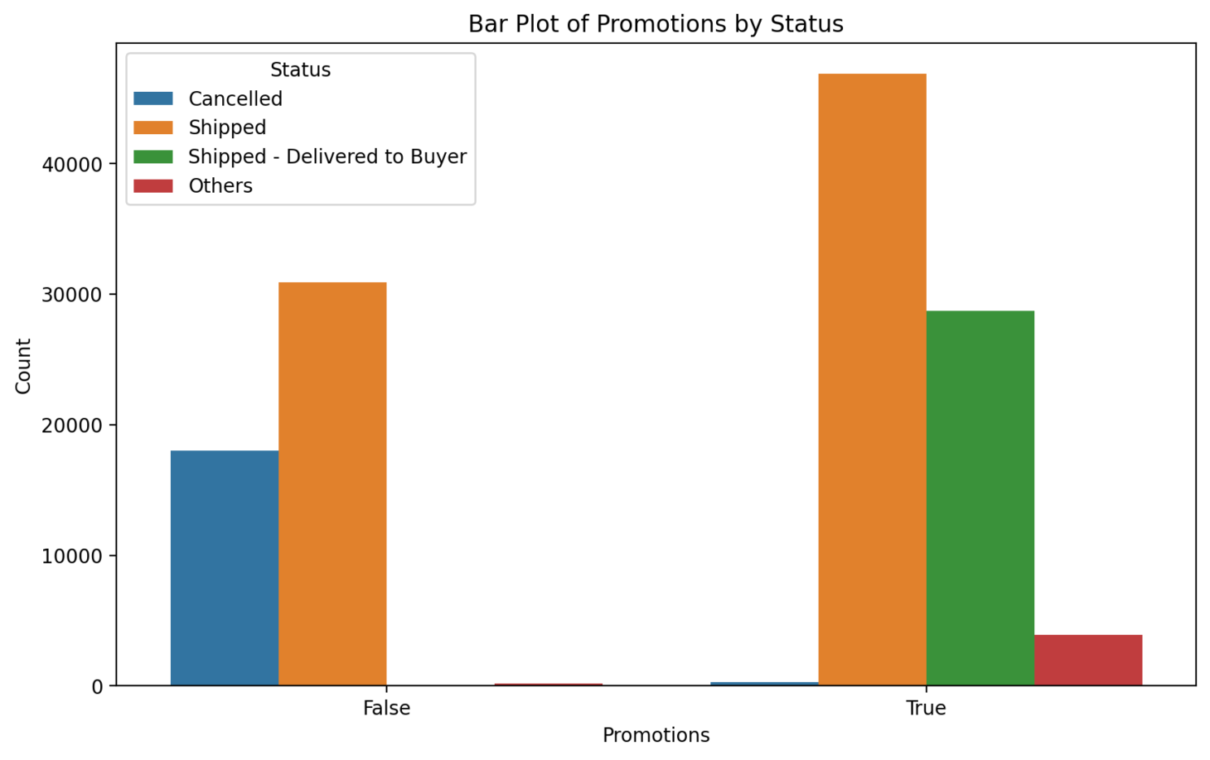
Promotions
From this visual it was obvious that promotions is a key differentiating feature

Slide 7
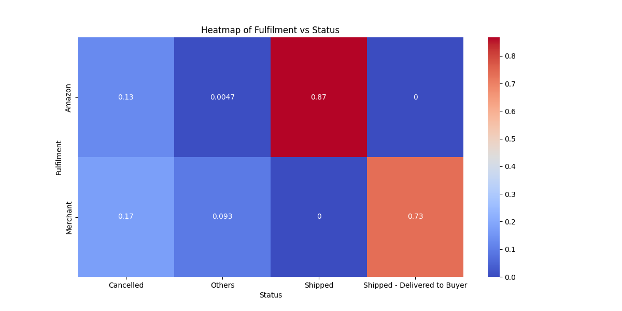
Fulfilment
This heatmap shows a great change of status with the fulfilment type and this reflects how valuable this feature is
Note this feature was renamed to Amazon and was turned to type bool
Also note that this feature is a mapping to the feature “fulfilled-by” and the feature “ship-state”

Slide 8
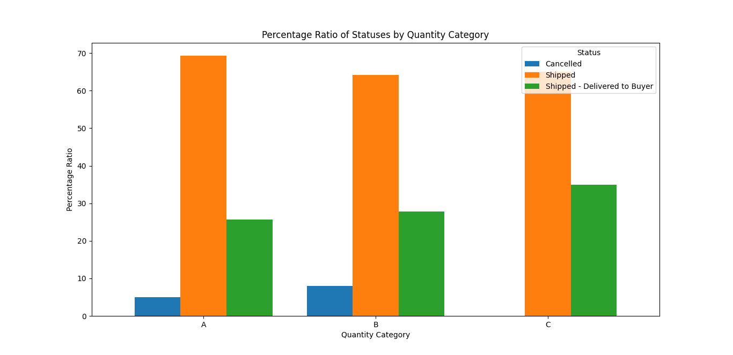
Numerical Data
Steps Taken:
Dimensionality reduction and insights from Qty and Amount columns
Decision made was to drop them
Visual support: Qty:
The quantity doesn’t show any distinction after mapping them to the following: A: 1
B: 2
C: more than 2

Slide 9
Conclusion
The conclusion was to Drop all columns except the promotions and fulfilment from the features
Regarding the target I decided on mapping it to (Canceled, Shipped, Shipped – Delivered to Buyer, Others)
It is to be noted that I haven’t been in a situation were I was compelled to make an interpolation or do any statistical calculation to fill out blank records because they were less than 0.03% of the columns that I found beneficial

Slide 10
The Model and the Streamlite
Model selection:
Considered Models:
Logistic Regression
Decision Tree Classifier
Random Forest Classifier
Chosen Model:
Logistic Regression
Lower computational demand
Interpretability

Slide 11
Model Evaluation
Performance Metrics:Precision (weighted): 0.8623
Recall (weighted): 0.8792
F1 (weighted): 0.8471
Accuracy: 0.8792

Slide 12
Cross-Validation
Cross-validation was used to ensure model robustness
Consistent performance across Logistic Regression, Decision Tree, and Random Forest models

Slide 13
Conclusion
Logistic Regression chosen for efficiency and consistent performance.
High accuracy and balanced metrics achieved.
Suitable for deployment with key features: "Promotions" and "Amazon."

